Slide 1
Lecture 5

Slide 2
The Role of Analysis

Slide 3
Software Development
Analysis
Design
Coding and Testing and Refactoring
Installation
Maintenance

Slide 4
Analysis
Understand the business processes: Gather the requirements: interviews of the user community, reading of any available documentation, etc.
Document the functionality required of the system. (Use cases)
Develop a conceptual model of the system, listing the conceptual classes and their relationships.

Slide 5
Requirements Gathering
Flaws in this step can be costly to fix.
Users are not always clear as to what they need.
Users may not know what the technology can do.

Slide 6
Types of Requirements
Functional
Non-functional: response time, usability, accuracy, etc.

Slide 7
What Does NOT Happen During Analysis
Design of the classes
Determining which programming languages to use
Distributed/Centralized
OS issues
Writing programs
Testing
Debugging
Installation

Slide 8
Case Study Introduction

Slide 9
Case Study: Requirements Outline
Register new members.
Add books to the collection.
Issue a book to a member(or user).
Record the return of a book.
Remove books from the collection.
Print out a user's transactions.
Place/remove a hold on a book.
Renew books issued to a member.
Notify member of book's availability.
Save data to disk.
Load data from disk.
Quit the application.

Slide 10
User Interface
Used by library staff
Commands:
Add a member.
Add books.
Issue books.
Return books.
Remove books.
Place a hold on a book.
Remove a hold on a book.
Process Holds.
Renew books.
Print out a member's transactions.
Store data on disk.
Retrieve data from disk.
Exit.

Slide 11
Use Case Analysis

Slide 12
Use-Case Analysis
It helps define and document the system requirements.
It describes the sequence of events (actions) of an external agent (actor) using the system to complete a process.
It comprises a separate use-case for each functionality.
A use-case has two or more parties: agents who interact with the system and the system.

Slide 13
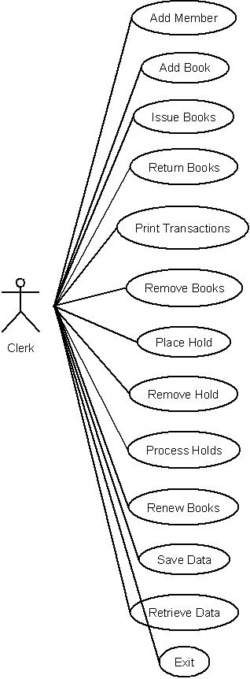
Use-Case Diagram

Slide 14
Use Cases

Slide 15
Use-Case for Registering a Member
Actions performed by the actor | Responses from the system
1. The customer fills out an application form containing the customer's name, address, and phone number and gives this to the clerk.
2. Clerk issues a request to add a new member.
 | 3. The system asks for data about the new member.
4. The clerk enters the data into the system.
 | 5. Reads in data, and if the member can be added, generates an identification number for the member and remembers information about the member. Informs the clerk if the member was added and outputs the member information that was stored.
6. The clerk gives the user his identification number.

Slide 16
Characteristics of Use-Cases
Every use-case has to be identified by a name.
It should represent a reasonably-sized activity in the organization.
The first step of the use-case specifies a ``real-world'' action that triggers the exchange described in the use-case.
The use-case does not specify how the functionality is to be implemented.

Slide 17
Use-Case for Adding Books
Actions performed by the actor | Responses from the system
1.The library receives a shipment of books from the publisher
2. The clerk issues a request to add a new book.
 | 3. The system asks for the identifier, title, and author name of the book.
4. The clerk generates the unique identifier, enters the identifier, title, and author name of a book.
 | 5. The system attempts to enter the information in the catalog and informs the clerk about the result. It then asks if the clerk wants to enter information about another book.
6. The clerk answers in the affirmative or in the negative.
 | 7. If the answer is in the affirmative, the system goes to Step 3. Otherwise, it exits.

Slide 18
Use-Case for Issuing Books
Actions performed by the actor | Responses from the system
1. The member arrives at the check-out counter with a set of books and supplies the clerk with his/her identification number.
2. Clerk issues a request to check out books.
 | 3. The system asks for the user id.
4. Clerk inputs the user ID to the system.
 | 5. If the ID is valid, the system asks for the ID of the book; otherwise it prints an appropriate message and exits the use-case.
6. The clerk inputs the identifier of a book that the user wants to check out.
 | 7. If the ID is valid and the book is issuable to the member, the book is recorded as having been issued to the member; Member is recorded as having possession of the book, a due-date is generated and details of the transaction are displayed. If the book is not issuable, a suitable error message is displayed. The system asks if there are more books.
8. The clerk stamps the due-date, prints out the transaction (if needed) and replies positively or negatively.
 | 9. If there are more books for checking out, the system goes back to Step 5; otherwise it exits.
10. The clerk stamps the due date and gives the user the books checked out. The customer leaves the counter.

